Slide 1

Scenario - Multimedia
Archway Charity Concert

Slide 2
Scenario
You have been employed to assist in the organisation and promotion of a live charity music concert to be held at your school for all the students who currently attend Archway Academy.
The bands and artists performing at the concert have agreed to provide their services free of charge so that more money can be raised for a chosen charity. You must decide on the bands and artists who will play at the concert. The date, timing, ticket prices, ordering details and other features (e.g. digital images; clipart; animations etc.) will also need to be decided so that these can be included in the interactive multimedia product you will design and produce.
Your presentation must have a suitable housestyle that uses the charity you have chosen as a basis for this.
You must design and produce a multimedia product in the form of an interactive multimedia presentation that could be viewed on a standalone touch screen in a foyer. It must be designed to allow the user to interact with the product so that they can find the information that interests them or that they need to know.
Your presentation needs to persuade the students of Archway Academy to purchase a ticket for the charity concert. You need to raise as much money as possible for your chosen charity.

Slide 3
In the space below write down all the things your presentation must include/ do:
Promote a charity concert
2.

Slide 4
Charity
You need to decide which charity you are going to support with your concert.
Research the charity of your choice and complete the following slide

Slide 5
Name of Charity
Charity Website
Charity Logo
What does the charity support and how?
Housestyle of the website (colours, logo, images, font etc)
Any other information
Extension: Create an animation about your charity in a drawing package.
You can then add this to your presentation

Slide 6
Tasks
In order to create your interactive product you will need to complete the following tasks:
Plan the product that meets all the needs of the scenario
Source (collect) multimedia components to use in your presentation
Create your product
Test your product whilst making it and once it has been completed.

Slide 7
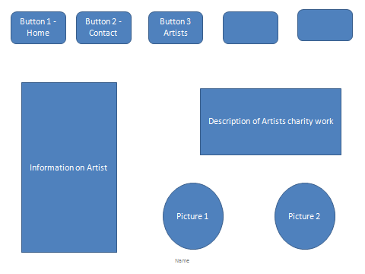
Example Layout

